Slide 1





DEGREE HUNTA Game in python…

Slide 2


INTRODUCTION
The game is based on the programming language called Python. The map of the game is designed on the structure of Aligarh Muslim University (AMU). The game assumes that on the day of convocation, the player got extraordinarily excited after receiving the degree that he lost it somewhere in the university premises. Now the player is given an opportunity to find his degree by answering some knowledgeable and sensible questions. Thus, the game is puzzling and adventurous.

Slide 3
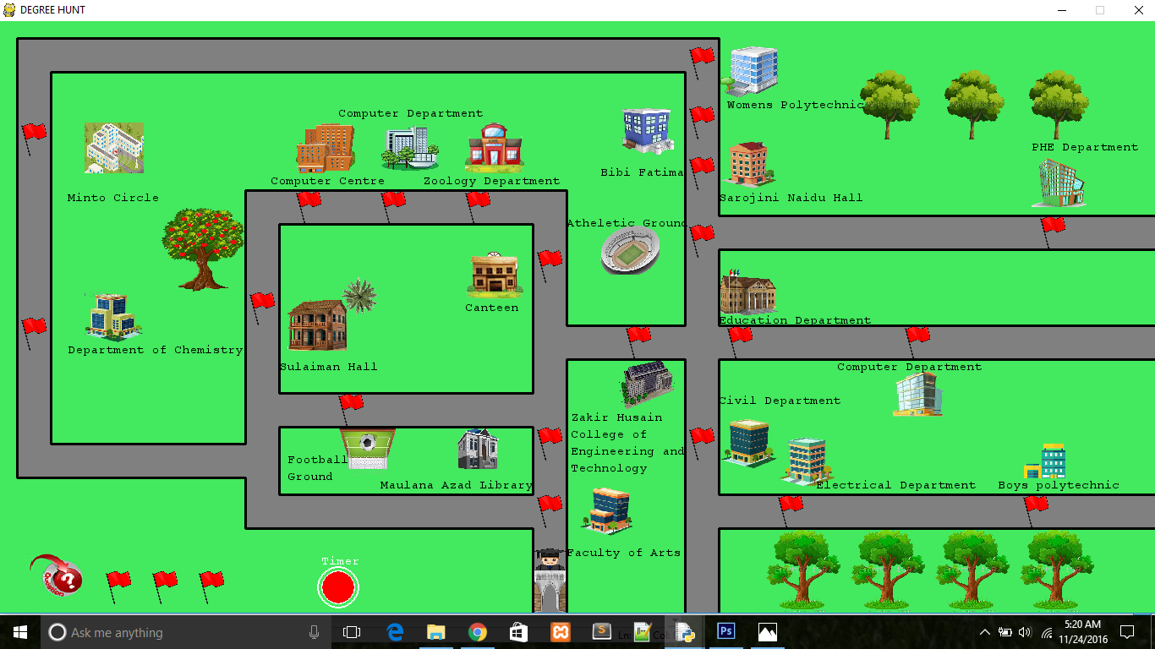
Insert the screenshot of the playing window only
MAP

Slide 4
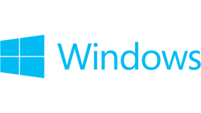

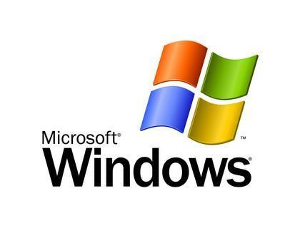
REQUIREMENTS
Hardware: Monitor, Keyboard and Mouse
Software:
Operating System: Windows 8 or 8.1 or 10
IDLE (Integrated Development Environment or Integrated Development and Learning Environment) for Python
Python (version 2.7.12)
Pygame (version 1.9.2)
Tkinter (version 8.5)
Easygui (version 0.96)

Slide 5
WHY PYTHON ?
Extensive Support Libraries: Shortens the length of code as many highly used programming tasks have already been scripted.
User-friendly Data Structures: Built-in list and dictionary data structures which can be used to construct fast runtime data structures.
Learning Ease and Support Available: Excellent readability and uncluttered simple-to-learn syntax which helps beginners to utilize this programming language.
Productivity and Speed: Clean object-oriented design contributes to the increase in its speed and productivity.
Game development: Pretty easier task than doing the same in Java or C++. Python has libraries like Tkinter, Pygame and PyOpenGl (for 3D) which help a lot in this process.

Slide 6


WHY PYGAME AND TKINTER ?
PYGAME
Easy to learn
TKINTER
Since the Tk toolkit has been around for a very long time(since 1991),it is more portable than any other GUI toolkit.
The Tkinter implementation hides the detailed and complicated calls in simple, intuitive methods.

Slide 7
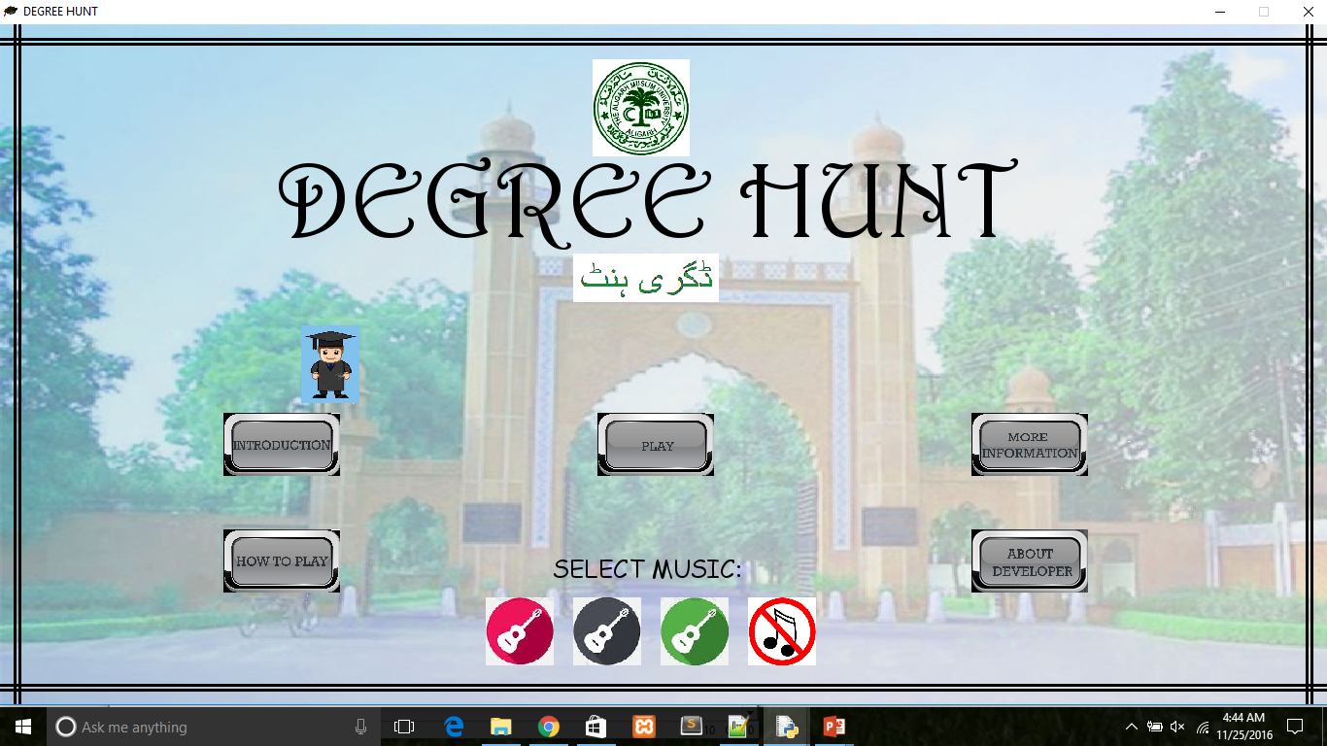
Insert the screenshot of the main window only
MAIN WINDOW

Slide 8
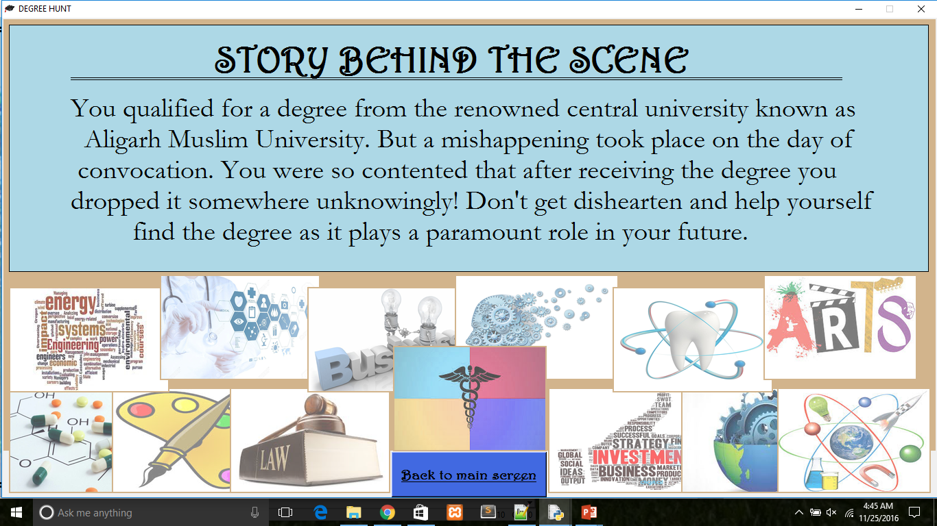
INTRODUCTION WINDOW

Slide 9
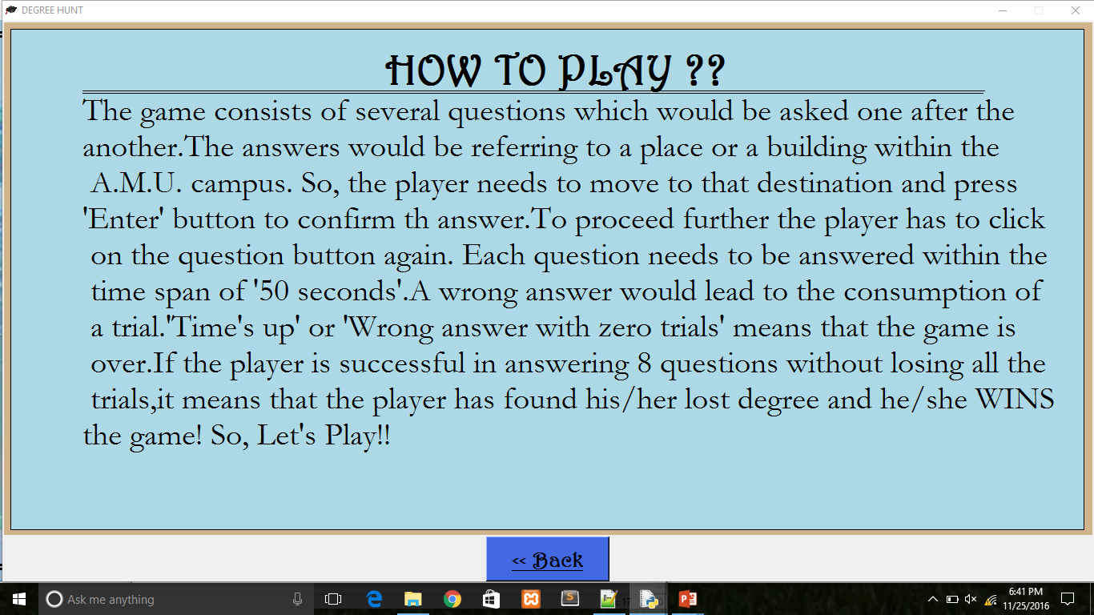
HOW TO PLAY WINDOW

Slide 10
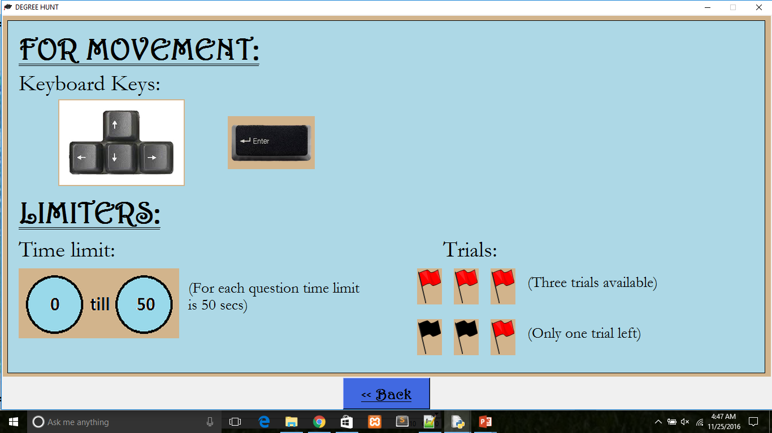
MORE INFORMATION WINDOW

Slide 11
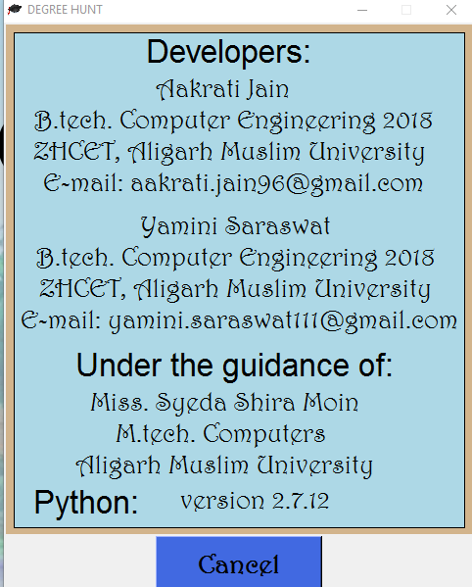
ABOUT DEVELOPER WINDOW

Slide 12
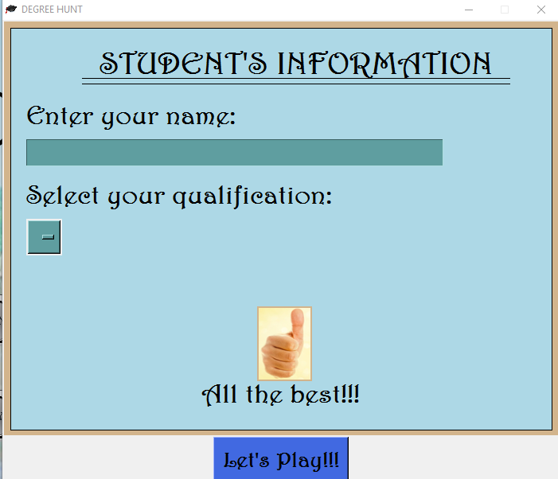
ENTRY WINDOW

Slide 13
PLAY WINDOW

Slide 14
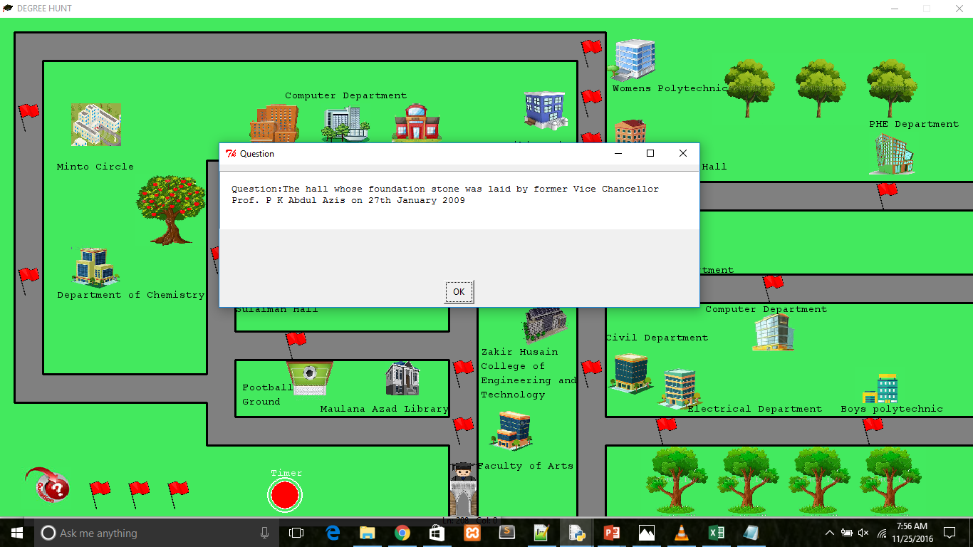
QUESTION POPUP

Slide 15
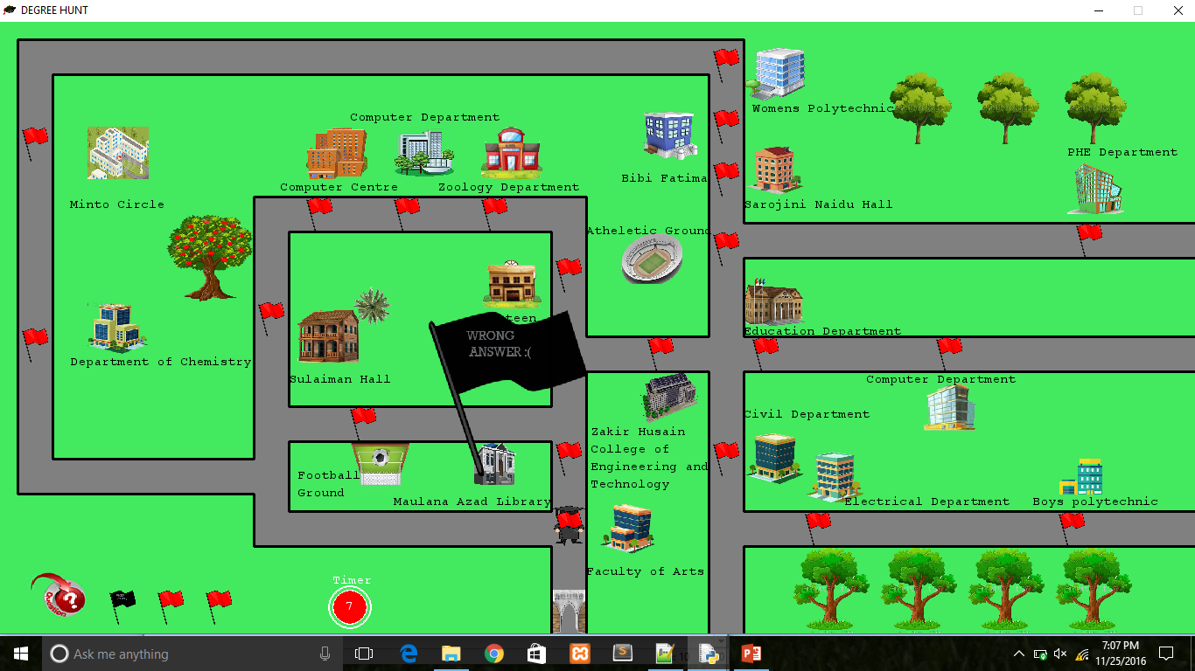
WRONG ANSWER

Slide 16
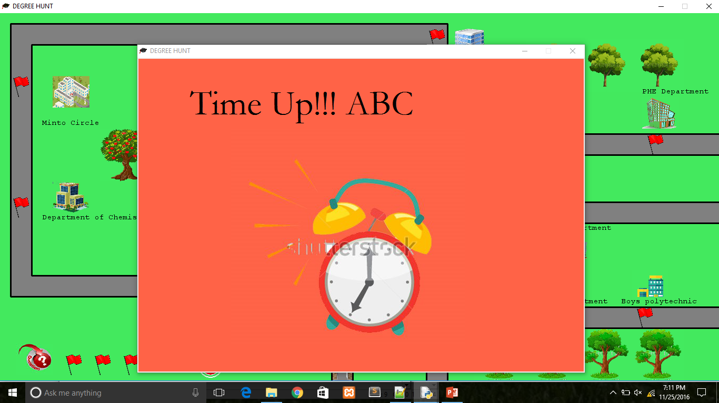
TIME UP WINDOW

Slide 17
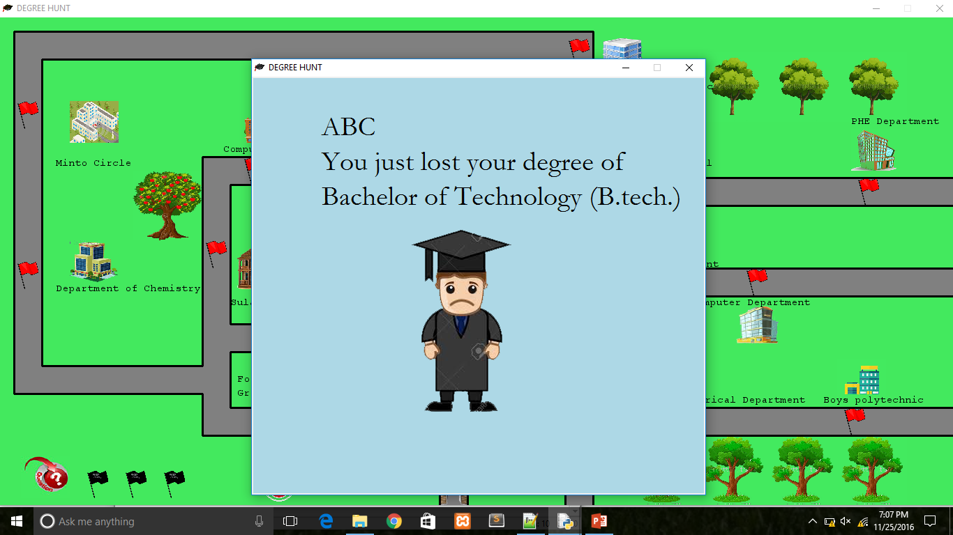
GAME OVER WINDOW

Slide 18
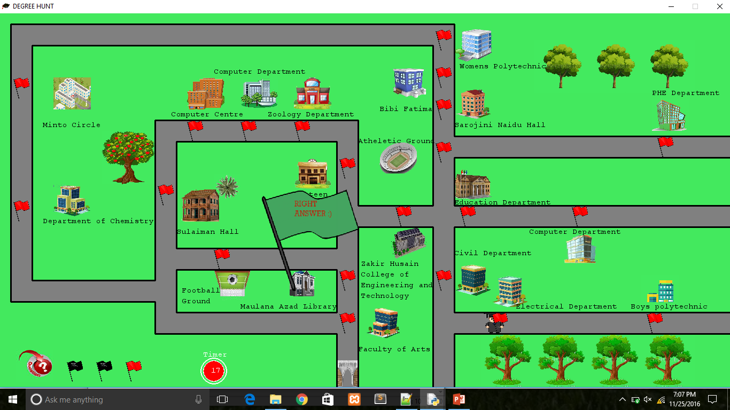
RIGHT ANSWER

Slide 19
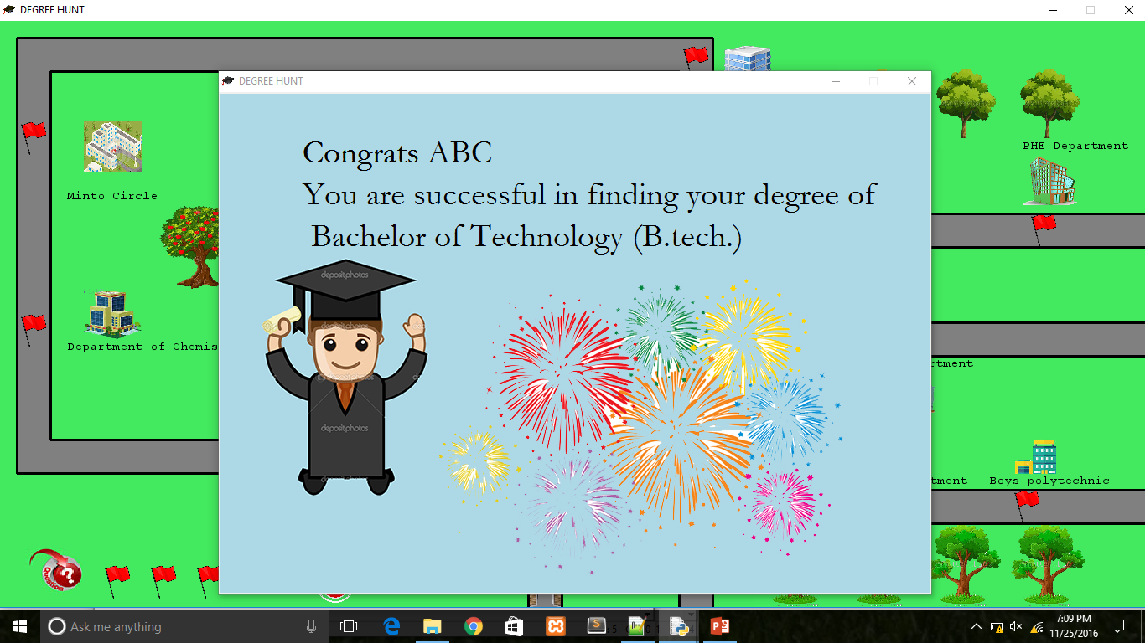
SUCCESS WINDOW

Slide 20
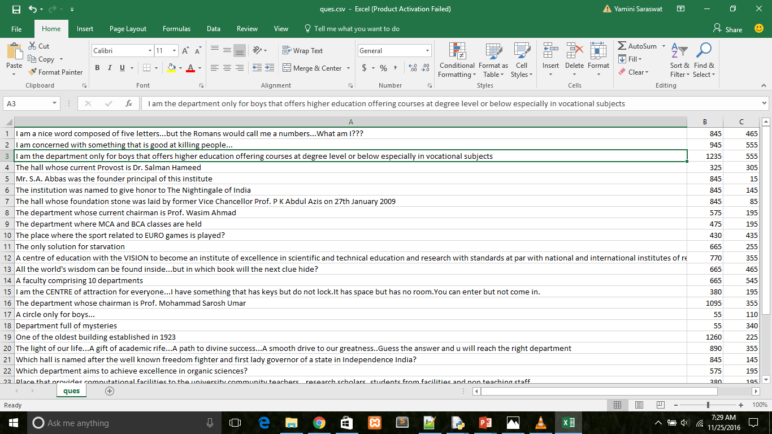
CSV FILE

Slide 21
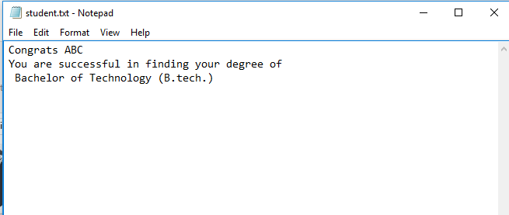
TEXT FILE

Slide 22


DRAWBACKS
PYGAME
it's really old and outdated in the way it draws things
it's hideously slow
it's hideously buggy
it's fairly badly documented
it does not run in the browser and on mobile platforms
TKINTER
it has fewer built-in widgets
it is slow
The multi-layered approach taken in designing Tkinter can have some disadvantages as far as execution speed is concerned.

Slide 23
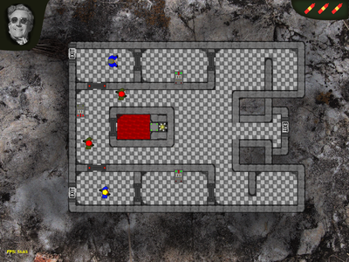
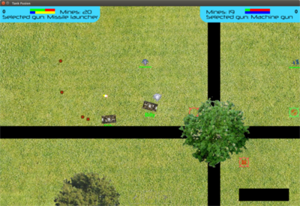
EXISTING EXAMPLES
NASHEES TO ASHES: A invasion puzzle game based on the movie Dr Strangelove.
Completion date: Oct 22, 2016
TANK FISSION: Tank Fission is python-pygame top down shooter for two players. Use mines, missiles, and machine guns to defeat your opponents
Completion date: Jun 12, 2016

Slide 24

REFERENCES
Reading material:
PyGame documentation
link: http://www.pygame.org/docs/
PyGame Video Tutorials:
Udemy - Learn Python_ The Complete Python Programming Course (2015)
Python (Python Game Development) by ‘thenewBoston’
link: https://www.youtube.com/watch?v=K5F- aGDIYaM&list=PL6gx4Cwl9DGAjkwJocj7vlc_mFU-4wXJq
PythonGame Development by ‘WilliamFiset’
link: https://www.youtube.com/watch?v=VCf5
hED4BG0&list=PLDV1Zeh2NRsB1l23YFY137LtPcstXKyuQ

Slide 25

By:
Yamini Saraswat and Aakrati Jain
THANK YOU…

